Slide 1
Introduction
Meal Calendar
By Tyler Long

Slide 2
Summary
Mission Statement
3 key processes
System Overview

Slide 3
Mission Statement
The goal of Meal Calendar is to give a collaborative means to answer the question “What are we having for dinner?”

Slide 4
3 Key Processes
Create a list of user defined Meals
Create a list of user defined Calendars
Adding Meals to a Calendar

Slide 5
System Overview: Routes
List of Routes:
Root
/meals
/calendars
/calendar/:calId

Slide 6
System Overview: Collections
List of Collections:
Meals
Calendars
Meteor users

Slide 7
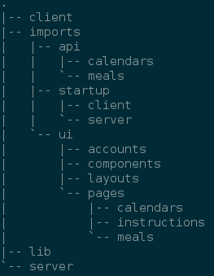
System Overview: System Files
Meteor v1.3 import style

